Slide 1

Netmiko
ssh-keygen -t ed25519 -C "shankarpradhan845@example.com"
What Is Netmiko?
Netmiko is a Python library used for network automation. It makes it easy to connect to network devices via SSH and run commands or push configurations automatically.
Why Netmiko is used (in real networks)?
As a network engineer, instead of:
Logging into 50 routers one by one
Running the same commands manually
You can:
Write one Python script
Connect to all devices
Execute commands/configs automatically

Slide 2
Playbooks
Ansible playbooks are like instruction manuals for your servers. They help you:
Automate tasks (install software, configure settings, deploy apps).
Keep everything consistent (no mistakes when setting up multiple servers).
Save time (run the same steps over and over without doing it manually).
Why Use Playbooks?
i. Repeatable
Run the same steps on 1 server or 1000 servers—exactly the same way every time.
Easy to Share & Reuse
Save playbooks as YAML files (like a text file).
Store them in Git (like a shared folder for code) so your team can use them.
iii. Great for Complex Apps
Need to set up a web server + database + firewall rules? A playbook can do it all at once.

Slide 3
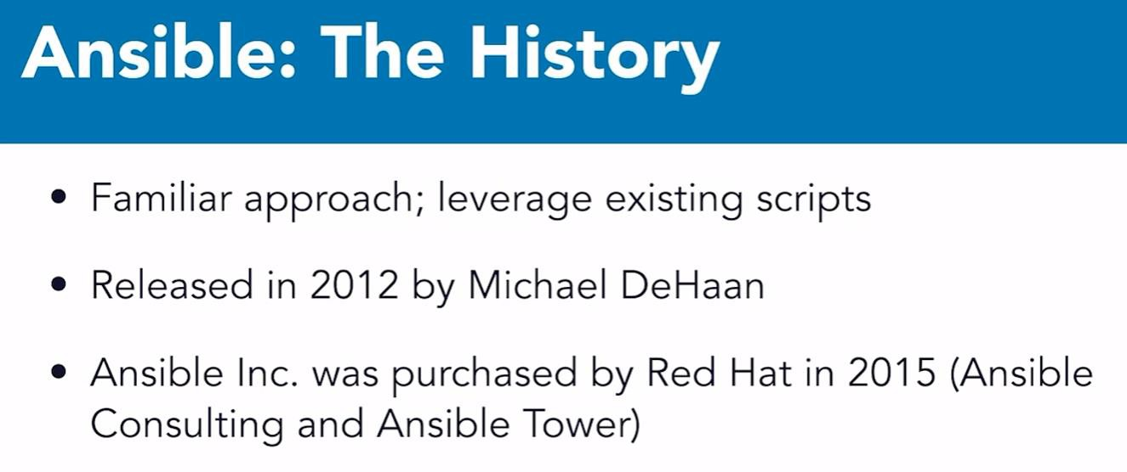


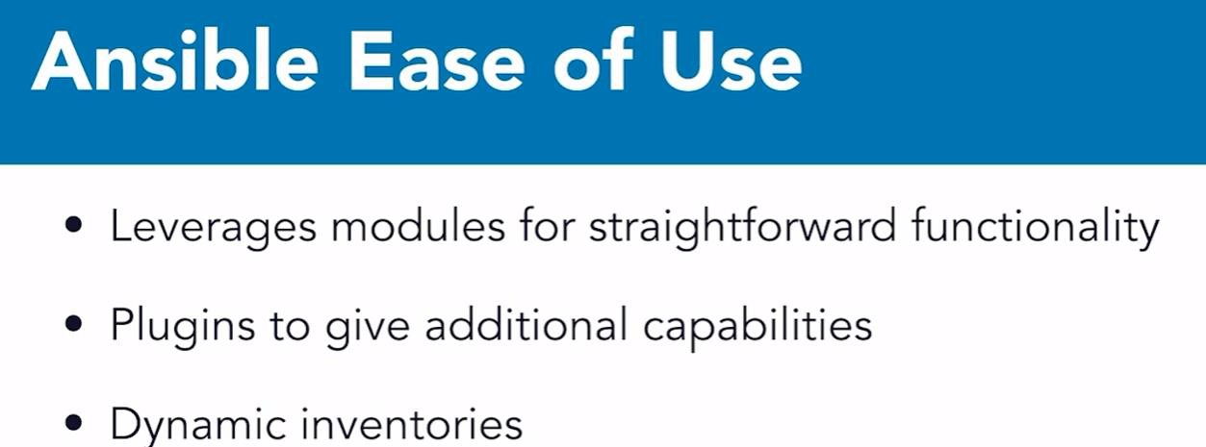


Slide 4



PLUGINS AND ROLES
In Ansible, both Plugins and Roles help modularize and extend functionality—but they serve very different purposes:
Ansible Plugins (Extend Ansible's Core Functionality)
What is a Plugin?
A plugin is a piece of code that extends how Ansible behaves. Ansible uses many types of plugins internally—for logging, output formatting, caching, connection handling, etc.
Common Types of Plugins:
Plugin Type Connection Plugin Callback Plugin Lookup Plugin
Description
Controls how Ansible connects to nodes (e.g., SSH, local, docker). Controls how output is displayed (e.g., default, JSON, minimal).
Fetches external data (e.g., from files, secrets managers). Adds custom Jinja2 filters (like custom string formatting).
Filter Plugin
Inventory Plugin
Dynamically generates inventory from sources like AWS, GCP, YAML.
Action Plugin
Controls task execution behavior.
Cache Plugin Caches gathered facts for speed.
Example: Callback Plugin to Show JSON Output ANSIBLE_STDOUT_CALLBACK=json ansible-playbook site.yml
Ansible Roles (Organize Reusable Configurations)
What is a Role?
A role is a structured way to group variables, tasks, handlers, templates, files, and modules—so they are reusable across multiple playbooks.
Example: Using a Role in a Playbook
yaml
- name: Configure web server hosts: webservers
roles:
- apache
If the role is in roles/apache/, Ansible will: Run tasks from apache/tasks/main.yml Use variables and templates as needed

Slide 5
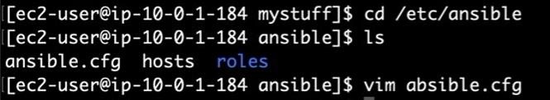
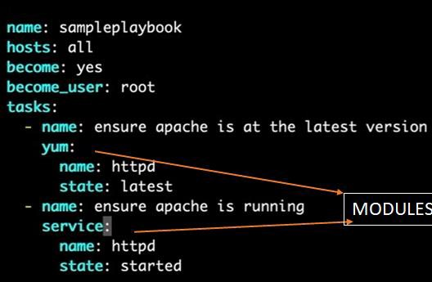
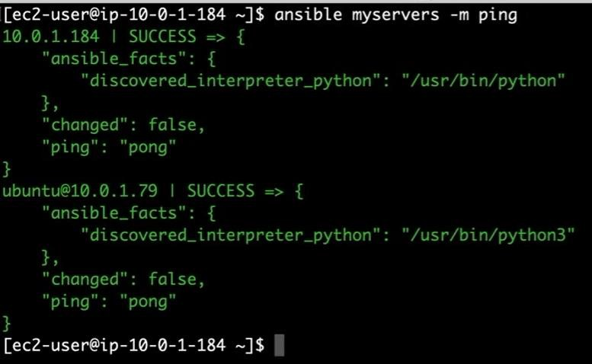

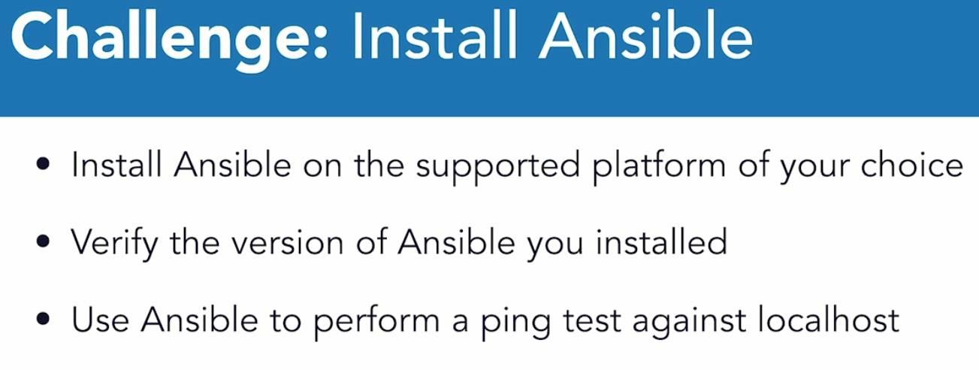
Ansible Commands
To escape out of the file after entering:
q!
To read a file in linux:
vim <file.ext>
To run ansible file all of the host inside the inventoy: (here we can see the problem)
ansible-playbook <file.yml>
s
We can check a particular host device by ping:

Slide 6
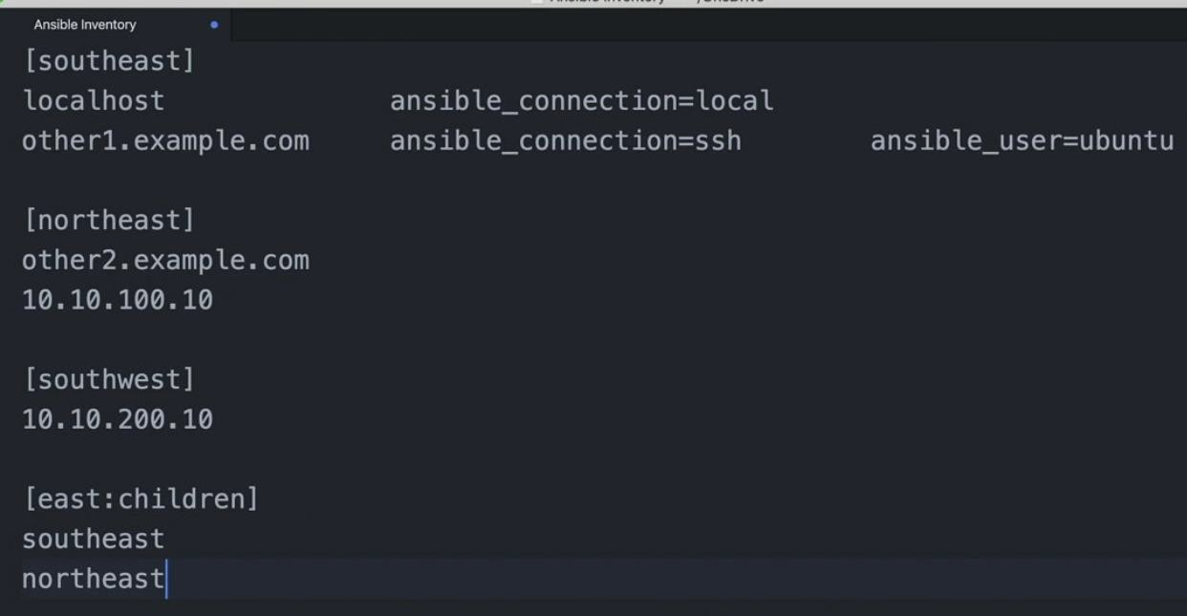






























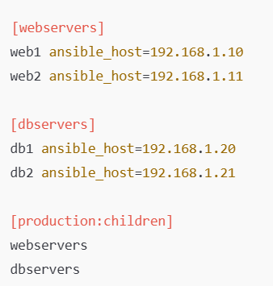
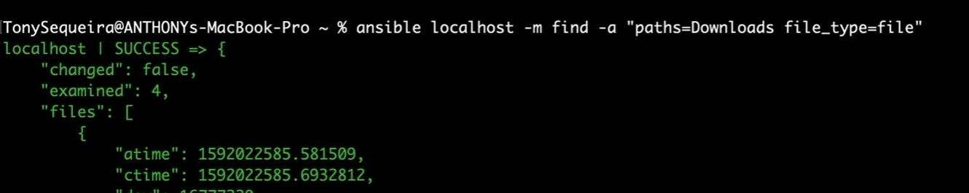
Working with hosts and Variables in Ansible
Mainly used in inventory file for our hosts.
Here, all the Localhost
squrare brackets[northeast…..]
are all groups by which we can access a number of hosts.
===== here we only need to use local to access
ansible_connection=local
other1.example.com ansible_connection=ssh ====== here we can use ssh to access the host
[east:children] ==== it is like a class/group where we can combine multiple group
MODULES

Slide 7
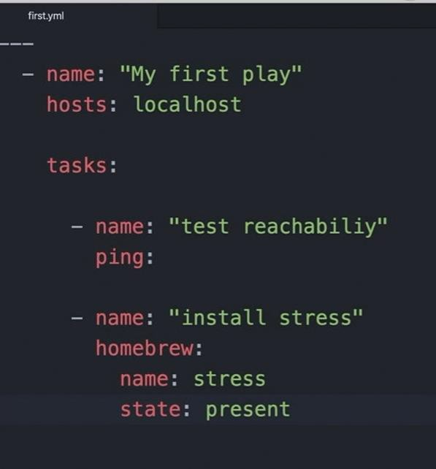
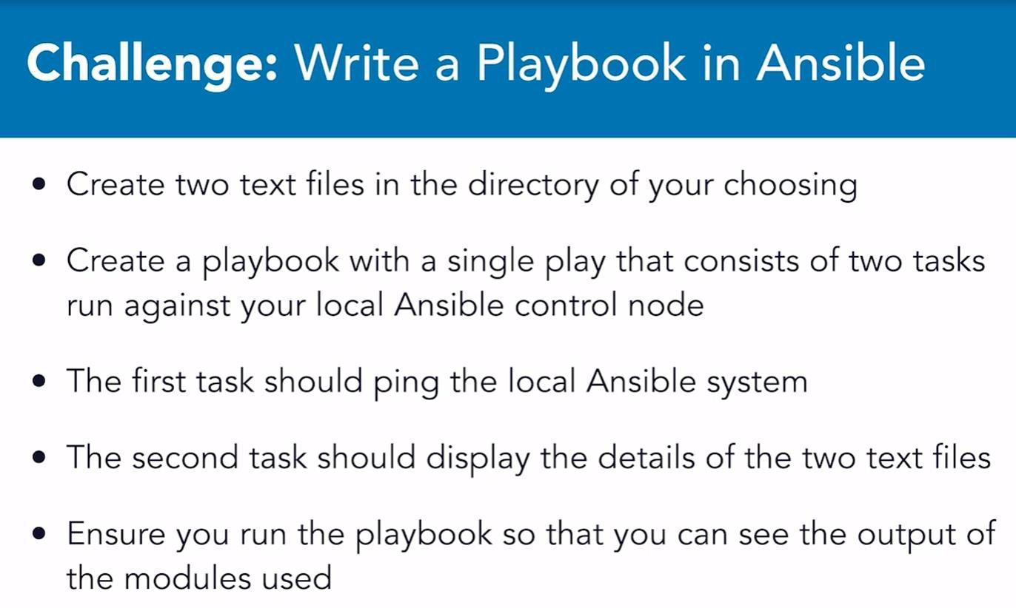

Working With Playbooks in Ansible
Mainly used in inventory file for our hosts.
File search:
sudo ansible localhost -m find -a "paths=. file_type=file patterns=shan.yml"
run yml file:
ansible-playbook wifi_ping.yml
Ping your device task:
---
name: ping to the local host hosts: localhost
tasks:
name: ping local ping:
Create an inventory file: tells the particular device ip to manage:
touch inventory.ini

Slide 8


What is an Ansible Playbook?
A Playbook is a YAML file containing one or more “plays.”
Each play defines:
Which hosts to run on,
What tasks to perform on those hosts,
And how to perform them.
Playbooks automate complex workflows and configurations.
What is an Inventory in Ansible?
An inventory is a file where you list all the machines (hosts) Ansible will manage.

Slide 9
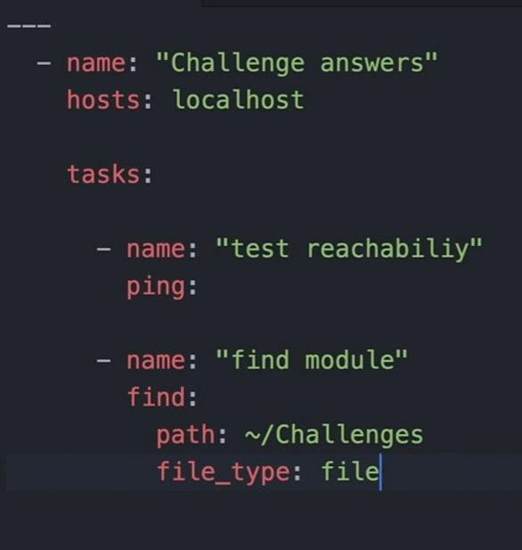
Ping other hosts
Create host file /etc/ansible nano <filename.ini>
insert:
[myrouter]
ansible_user=admin ansible_password=yourpassword ansible_connection=ssh
Create two text files and ping localhost
---
name: Create two text files hosts: localhost
tasks:
name: ping localhost ping:
name: Create file1.txt copy:
content: "This is file 1" dest: “./file1.txt"
name: Create file2.txt copy:
content: "This is file 2" dest: “./file2.txt“
Any file present inside the path (challenges) , it will just find.
run to check the file:
ansible-playbook <filename.yml> -v

Slide 10
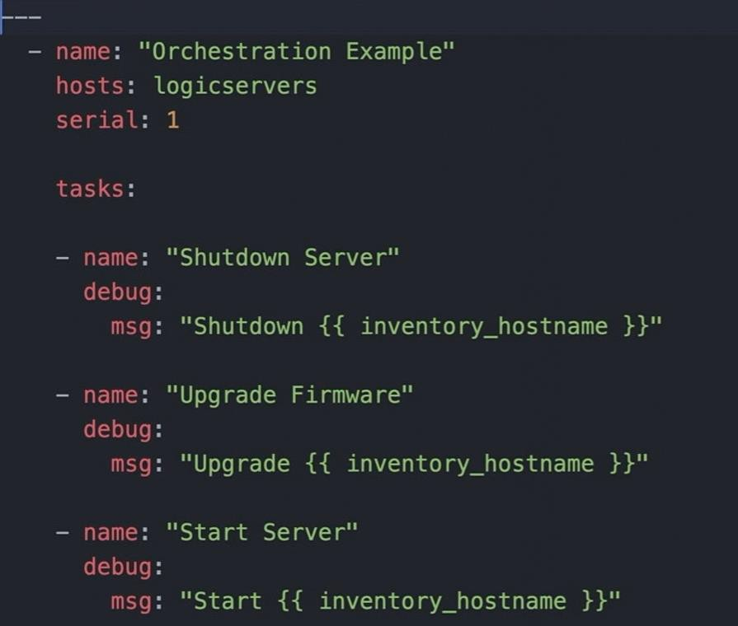
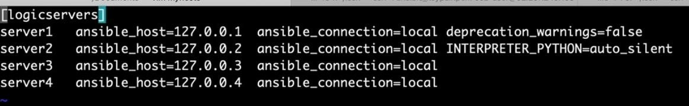
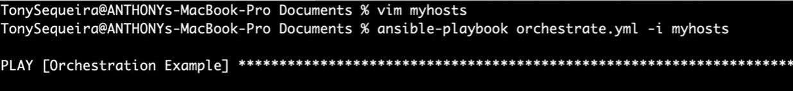
How ansible access remote-system
For Linux/Unix (SSH)
For Windows (WinRM)
Automation and Orchestration
Automation refers to a single task.
Orchestration refers to the management of many automated tasks.
Often a complicated ordering with dependencies.

Slide 11
Automation vs. Orchestration: Key Differences & Tools
Automation and orchestration are critical in DevOps, Cloud, and IT Ops, but they serve
different purposes. Here’s a breakdown:
Automation (Task-Level)
Definition: Automating individual tasks (e.g., restarting a service, installing software). Goal: Replace manual, repetitive work with scripts/tools.
Examples of Automation
Ansible (Run ad-hoc commands or playbooks)
ansible webservers -m service -a "name=nginx state=restarted“
Bash/Python Scripts (Custom automation)
Cron Jobs (Scheduled tasks)
Orchestration (Workflow-Level)
Definition: Coordinating multiple automated tasks across systems to achieve a larger goal. Goal: Manage complex workflows (e.g., deploying an app, scaling cloud resources).
Examples of Orchestration
Kubernetes (K8s) – Manages containers, scaling, networking.
Terraform – Provisions cloud infrastructure in order.
CI/CD Pipelines (Jenkins, GitHub Actions) – Automates testing → deployment.
Key Differences
Feature | Automation | Orchestration
Scope | Single task | Multi-step workflow
Tools | Ansible, Bash | Kubernetes, Terraform
Example | Install Nginx | Deploy full app (DB + Web + LB)

Slide 12
Orchestration in Ansible
Orchestration refers to coordinating and managing multiple tasks, plays, or playbooks across different systems in a specific order to achieve a desired state. It involves:
Managing dependencies between tasks.
Controlling the order of operations across multiple hosts.
Handling rolling updates, canary deployments, and complex workflows. Serialization in Ansible
Serialization is a subset of orchestration where tasks are executed one after another (sequentially) rather than in parallel. This is controlled using:
serial keyword (to limit how many hosts run at once).
strategy: linear (default, runs task on all hosts before moving to the next task). strategy: free (allows hosts to run independently).
Key Difference
Orchestration = Managing workflows across multiple systems (e.g., deploying app servers only after the database is ready).
Serialization = Controlling how many hosts execute a task at a time (e.g., updating servers in batches of 2).
Ansible For System Configuration
Designed to be minimal in nature
Agentless
SSH
State Driven – It can examine the state of machine and it can decide whether or not actions need to be taken
Idempotent – we can safely execute actions with ansible against systems and not have determintal effect on those systems.

Slide 13
Orchestration
---
name: Test Local Ansible Orchestration hosts: local
gather_facts: yes
become: yes # Run as sudo if needed means root level access
tasks:
name: Create a test directory
file:
path: /tmp/ansible_test state: directory
mode: '0755'
name: Write a test file copy:
content: "Hello, Ansible running locally!" dest: /tmp/ansible_test/test.txt
name: Install a package (e.g., htop) apt: # For Debian/Ubuntu
name: htop state: present
when: ansible_os_family == 'Debian'
name: Print a message debug:
msg: "Ansible is working locally!"

Slide 14

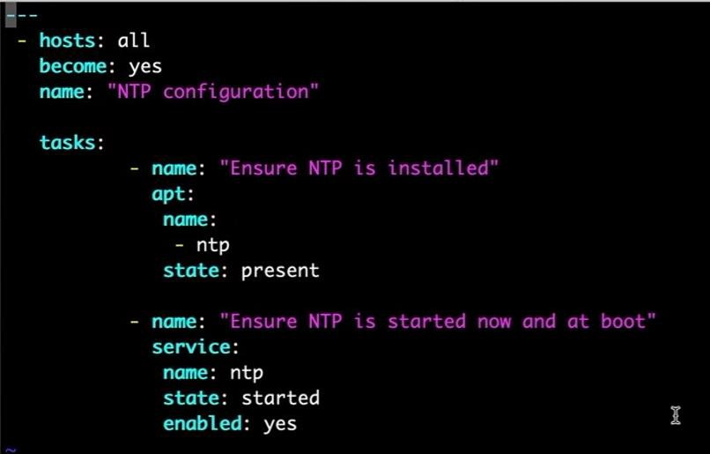
e.g: Ansible For System Configuration
hosts: all
Meaning: Specifies the target hosts for the playbook. U can also define it for a single system like webserver.
become: yes
Meaning: Enables privilege escalation (run tasks as root or another privileged user). Details:
Equivalent to using sudo on Linux.
Required for tasks like installing packages (apt) or managing services (service).
Taks
- name: "Ensure NTP is installed"
apt:
name:
- ntp
state: present
name (task description): Explains the task’s purpose (for logging/debugging).
apt: Ansible module to manage packages on Debian/Ubuntu. name: ntp: Specifies the package to install.
state: present: Ensures the package is installed (alternatives: absent, latest).
- name: "Ensure NTP is started now and at boot"
service:
//chronyd -- same
name: ntp
state: started
enabled: yes
service: Ansible module to manage services. name: ntp: Targets the ntp service.
state: started: Ensures the service is running immediately. enabled: yes: Ensures the service starts automatically at boot.

Slide 15
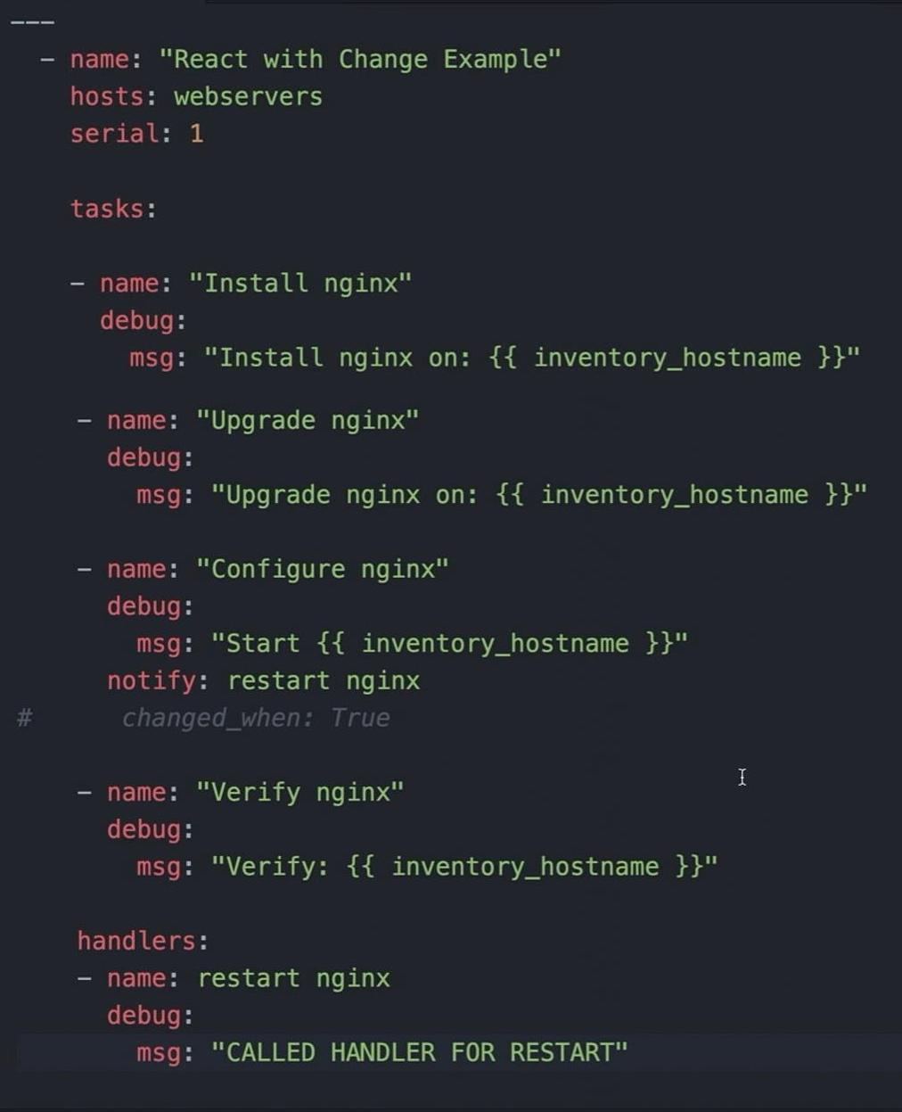
e.g: Ansible For System Configuration
In Ansible, handlers are special tasks that only execute when notified by another task. However, if the changed_when condition is not properly configured, the handler will not trigger, even if a task reports a change.
Task: Updates a config file only if changes are detected. Handler: Restarts the service when notified.
Verification: Use -v or --check to validate behavior before full execution.

Slide 16
i. Remove changed_when (Recommended)
Let Ansible detect changes naturally:
tasks:
- name: Update config file # Descriptive task name
template:
src: config.j2 # Jinja2 template source
dest: /etc/app/config.conf # Destination path on remote system
owner: root # Optional: Set file ownership
group: root # Optional: Set file group
mode: '0644' # Optional: Set file permissions (e.g., rw-r--r--)
notify: Restart service # Notifies the handler if the file changes
ii. Use changed_when Correctly
If you must use changed_when, ensure it evaluates to true when a change occurs: yaml
tasks:
- name: Update config file (conditional change)
template:
src: config.j2
dest: /etc/app/config.conf
notify: Restart service
changed_when: "'modified' in template_result"
# Custom logic to detect changes
iii. Force Handler Execution
If you always want the handler to run (even without changes), use meta:
tasks:
- name: Force handler execution
meta: flush_handlers

Slide 17
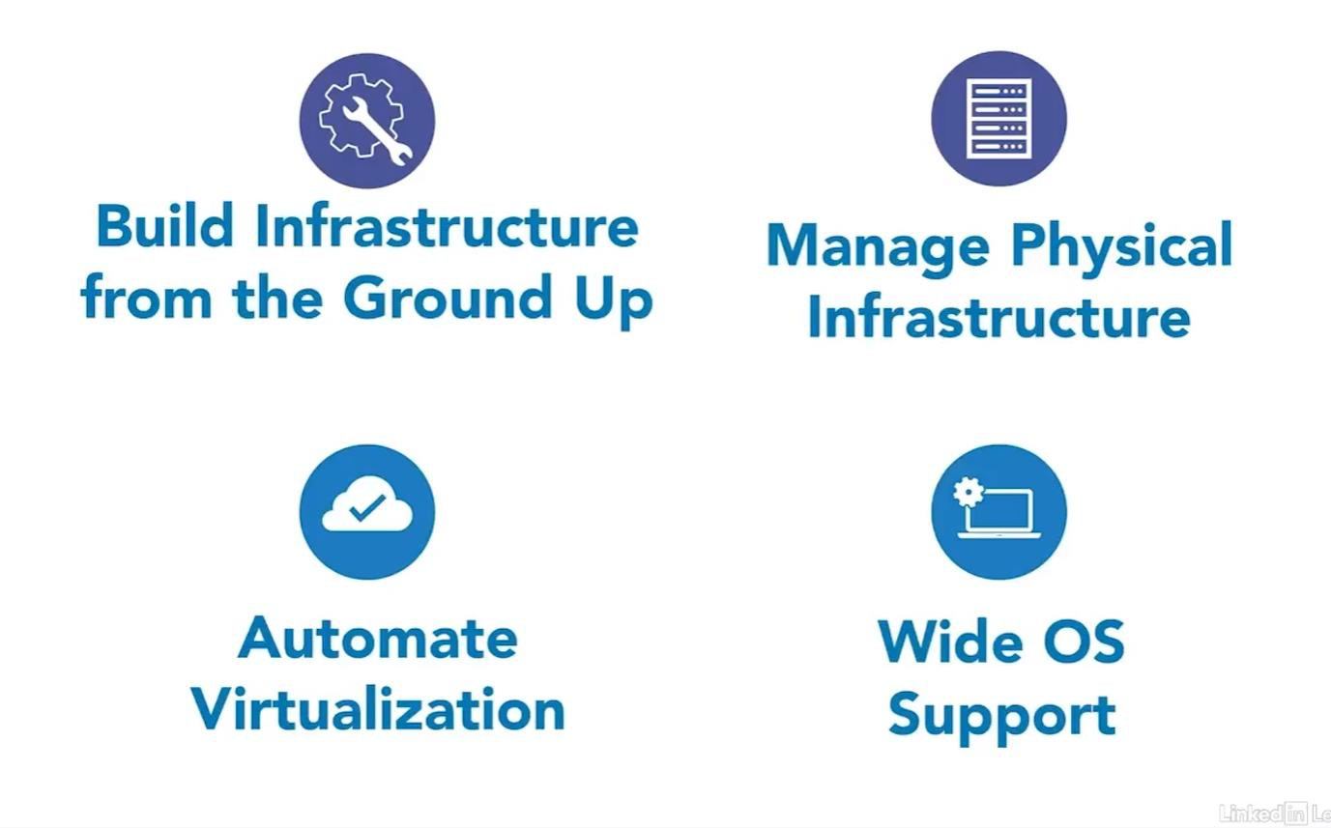
Infrastructure Management With Ansible
How Ansible Works with Cloud Technologies
i. Build Cloud Infrastructure Automatically
Use Ansible playbooks to create servers, networks, and storage in the cloud—like magic!
No manual setup: Ansible can provision the hardware (VMs, containers, etc.) for you.
Dynamic Inventory = Real Time Tracking
Ansible’s dynamic inventory updates itself when you add/remove cloud servers.
Example: If AWS creates a new VM, Ansible instantly knows and can manage it.
Manage Virtualization Easily
Ansible sets up the physical parts (servers, networks) first.
Then, it automates virtualization (like Docker, Kubernetes, or VMware) on top.
Works with Any OS
In the cloud, you might use Linux, Windows, or macOS.
Ansible supports all of them, making it perfect for mixed environments.

Slide 18


Repeating Tasks Across Fleets With Ansible
An ad-hoc command is a quick, one-time task you run with Ansible—without writing a full playbook.
Think of it like:
Typing a single command in the terminal to do something fast.
Useful for quick checks or simple changes (e.g., restarting a service, checking disk space).
Example Commands:
Ping all servers (check connectivity):
ansible all -m ping
for particular inventory: add “filename” at the end
Restart a service (e.g., Nginx):
ansible webservers -m service -a "name=nginx state=restarted" -b (-b = run as admin/sudo)
Check disk space:
ansible db_servers -m shell -a "df -h“
Install a package (e.g., htop):
ansible all -m apt -a "name=htop state=present" -b
When to Use Ad-Hoc vs. Playbooks?
Ad-Hoc Commands Quick, one-time tasks Testing/debugging Just do this now
Playbooks
Repeatable, complex setups Full automation
Always do this correctly
Execute the playbook on all servers
ansible-playbook -i hosts.ini main.yml
Execute the playbook on single servers
ansible-playbook -i hosts.ini main.yml --limit webservers

Slide 19
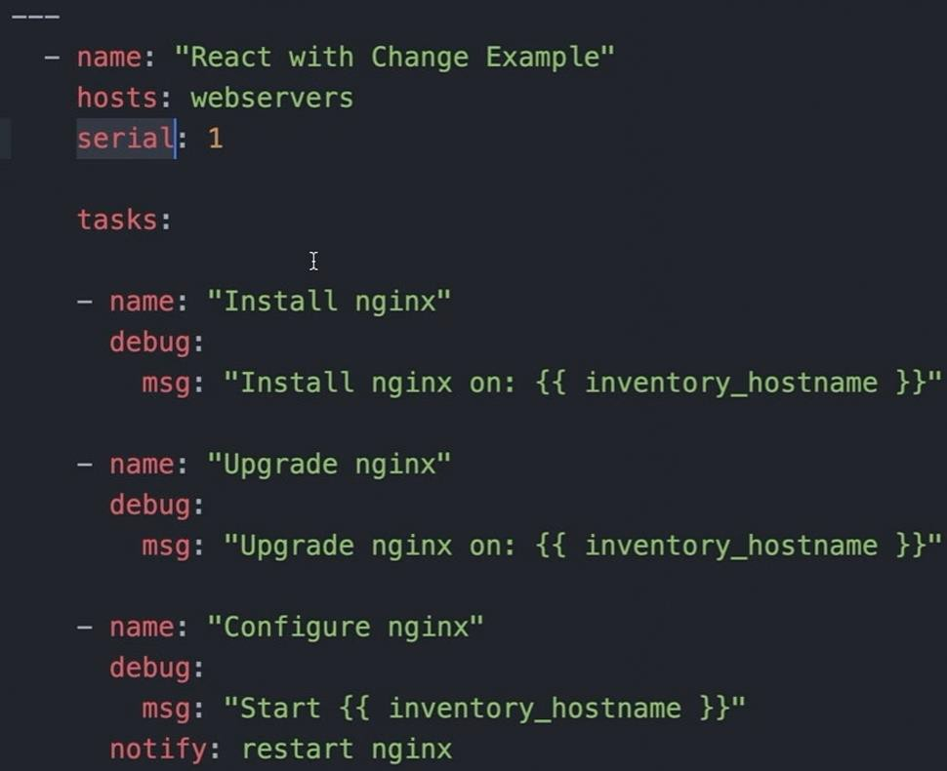
Serial: 1
Everything run at one host then move to the next host
Strategy: free (available inside ansible)
Each host runs independently.
As soon as a host finishes a task, it can proceed to the next one — without waiting for the other hosts
Folk tell in how many systems, it should execute:
Ansible-playbook file.yml –f myhost
10

